Slide 1

VFW AUXILIARY MEMBERSHIP MOMENT
How to Ensure a Membership Application is Complete

Slide 2
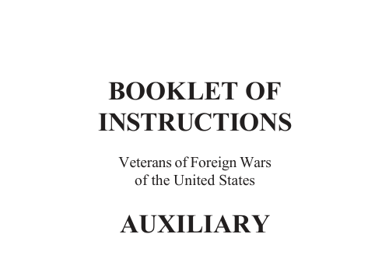
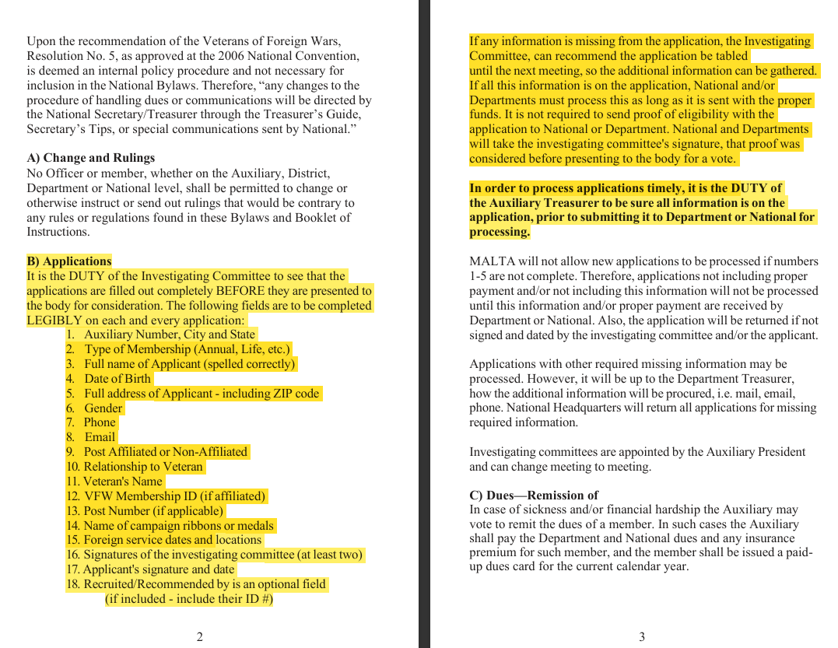

Slide 3
GETTING STARTED
One of the most critical steps in considering a new member for the VFW Auxiliary is the careful review of the prospective member’s application details by a three-member Investigating Committee appointed by the Auxiliary President (as outlined in Section 102 of the VFW Auxiliary Bylaws and Ritual).
As an exclusive veterans’ service organization, the VFW Auxiliary must ensure that every prospective member’s eligibility has been thoroughly vetted by an Investigating Committee before any action can be taken on the application. According to Page 1 of the VFW Auxiliary Booklet of Instructions, “it is the duty of the Investigating Committee to see that the applications are filled out completely before they are presented to the body for consideration.” The following fields are to be completed on each application:
• Recruited by
• Auxiliary Name and Number
• Kind of Membership (annual, life, etc.)
• State
• Name (spelled correctly)
• Date of Birth
• Address
• Gender
• City, State, Zip
• Phone
• E-mail
• Post Affiliated or Non-Affiliated
• Relationship
• Veteran (name)
• Post Number (if applicable)
• Name of campaign ribbons or medals
• Foreign Service dates
• Location
• Applicant’s signature and date
• Signatures of the Investigating Committee (at least 2)
• Signature line following the Obligation

Slide 4
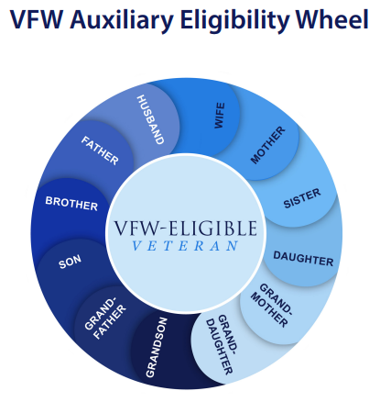

Slide 5
INVESTIGATING COMMITTEE DUTIES
In addition to the prospective member’s application, it is the responsibility of the Investigating Committee to review proof of honorable service of the eligible veteran, unless he/she is a member of the VFW Post to which the applicant is applying for membership.
Proof of the veteran’s honorable service in any foreign war, insurrection or expedition (as a member of the U.S. Armed Forces) may be determined through careful examination of a Separation Document (DD214) with a VFW-authorized campaign or service medal of the United States; receipt of Hostile Fire or Imminent Danger Pay, as verified by a copy of a Leave and Earning Statement (LES) issued by the U.S. Armed Forces; or service in Korea for 30 consecutive/60 non-consecutive days after June 30, 1949.
Performance reports, travel orders, medical orders, medals reports, morning reports, assignment listings, buddy affidavits, and letters from a foreign war zone may also be reviewed if a DD214 is not available. For veterans pre-1946, a report of their discharge listing the medals and decorations that were earned is acceptable proof
For soldiers currently on active duty, they will not have a DD214. In those cases, the appropriate orders showing overseas deployment to a qualifying area, or awarding of an authorized campaign medal, or a LES showing Hostile Fire/Imminent Danger pay will suffice to prove eligibility

Slide 6
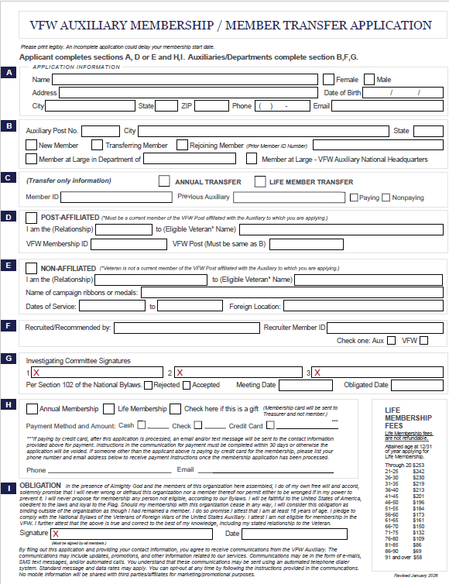
VFW AUXILIARY
MEMBERSHIP APPLICATION

Slide 7
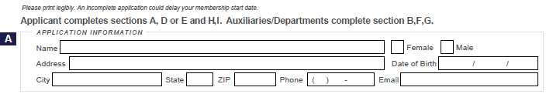
ALL Applicant Information must be provided and legible
PART A:
Name: As they want it on the card
Female or Male Check the appropriate box
Address: Where mail is received
Date of Birth: Must be provided
City/State and Zip: Where mail is received
Phone number: If no phone number….indicate “NONE”
Email address Please ensure that the email address is clearly written..or indicate “NONE”

Slide 8
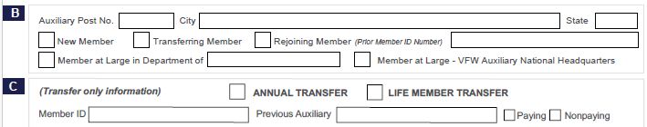
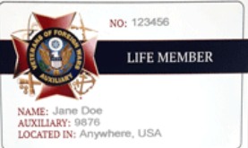
ALL Applicant Information must be provided and legible.
PART B:
The Auxiliary Post No, City and State is the Auxiliary is where the applicant is joining (not the Auxiliary No. if already a member and transferring to your Auxiliary.
MARK the appropriate reason for the application:
NEW Member TRANSFERRING Member REJOINING Member (provide Member ID #)
PART C:
If “TRANSFER” … check the type of Membership {Annual or Life Member)
Member ID (if already a member): If the applicant is a current, lapsed or former member of another auxiliary, their Membership ID number and Previous Auxiliary should be provided

Slide 9

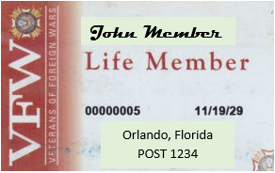
PART D:
Post-Affiliated: Check this box if the applicant is joining the Auxiliary under a current VFW member of the same VFW Post.
The VFW member must be a current member of the SAME VFW Post associated with the AUXILIARY the applicant is joining.
MUST provide the VFW Member’s Name (Eligible Veteran)
VFW Member ID# and VFW Post No.

Slide 10

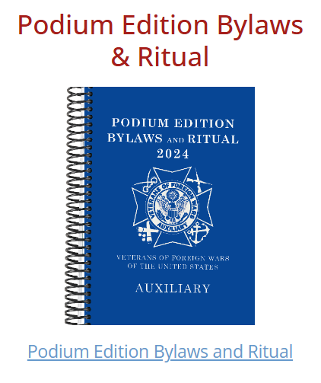
PART E :
Non-Affiliated: the eligible veteran is not a member of the VFW Post to which the applicant is joining
Relationship: Mother, Father, Sister, Brother etc.... To eligible Veteran: the veteran’s name
Name of campaign and any ribbons or medals: As found on DD214 or other paperwork available. You should always reference the National Auxiliary Bylaws page 6-11 and follow the guide in determining eligibility.
Note: There is no need to list all medals/ribbons, only those that qualify the veteran for the VFW, i.e., Vietnam Service Medal, Asiatic-Pacific Campaign, American Campaign, Korean Service Medal)
Dates of Service: the day they joined the military to the day they separated from the service.
Location: Foreign location where the veteran served….not the base where they served after returning to US
NOTE: The following does not qualify the applicant for the VFW Auxiliary under the service of their veteran:
National Defense Medal
WWII Victor Medal (only WWI Victory Medal) or just the notation WWII, unless foreign location provided or if the veteran was stationed at ‘Pearl Harbor’ at the time of hostile wartime.
Reference Pages 6 – 11 in the Podium Edition Bylaws and Ritual available in MALTA under Member Resources

Slide 11
PART F:
Recruited/Recommended by: The individual who is recommending (recruiting) the applicant for membership to the auxiliary. The individual recommending the applicant cannot be one of the Investigating Committee members signing the application.
Recruiter Member ID: This is the Recruiter’s Member ID. National now keeps track of this for auxiliary recruiters and they will mail Recruiter pin(s) when the criteria has been met. If the Recruiter Member ID is missing or incorrect, it will not be entered into MALTA at the time of processing.
The signature of the member recruiting/recommending the applicant cannot also be one of the Investigating Committee Signatures for the applicant

Slide 12

PART G:
Investigating Committee Signatures: Must have at least two (2) Investigating Committee signatures and cannot also be listed as the Recruiter (Refer to Section 102 of the National Bylaws)
Rejected: the applicant was not approved by a vote of the auxiliary to become a member
Accepted: the applicant was approved by a vote of the auxiliary to become a member
Meeting Date: The meeting date that the application was rejected or approved by the members. This date must be included on the application before sending to Department for processing.
Obligated Date: This is the date the applicant signed the OBLIGATION at the bottom of the Membership application or the Meeting Date if you are unsure of the signature date.

Slide 13
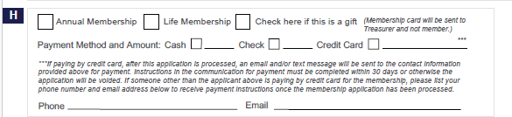
PART H:
Membership: The appropriate box must be checked indicating the type of membership “Annual” or “Life” the applicant has selected.
Payment Method and Amount: The appropriate box must be checked indicating the payment method the applicant is paying the required membership fees. If “Credit Card” is selected… DO NOT write in the applicants Credit Card number!
***If paying by credit card, after this application is processed, an email and/or text message will be sent to the contact information provided above for payment. Instructions in the communication for payment must be completed within 30 days or otherwise the application will be voided. If someone other than the applicant above is paying by credit card for the membership, please list your phone number and email address below to receive payment instructions once the membership application has been processed.

Slide 14
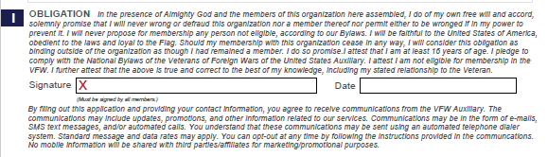
PART I:
Obligation: this is the obligation from the applicant/member to the auxiliary and their attest that all the information on the application is true and correct.
Signature and Date: the applicant/member’s signature and date of signature

Slide 15
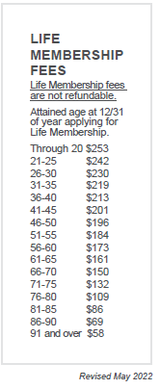
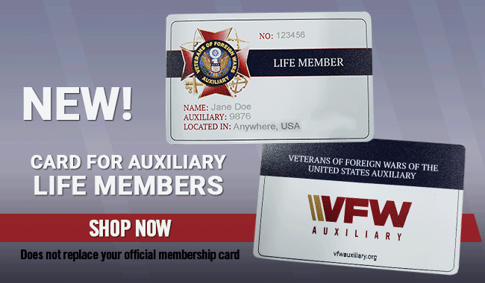
Life membership fees are determined based on the age the applicant will be by 12/31 of the year they are becoming a member.
For Example:
Date of Birth: 10/17/1954
Date of Application: 08/15/2024
2024
- 1954
70 the age the applicant will be by 12/31/2024
Life Membership Fees due with the application are $150

Slide 16
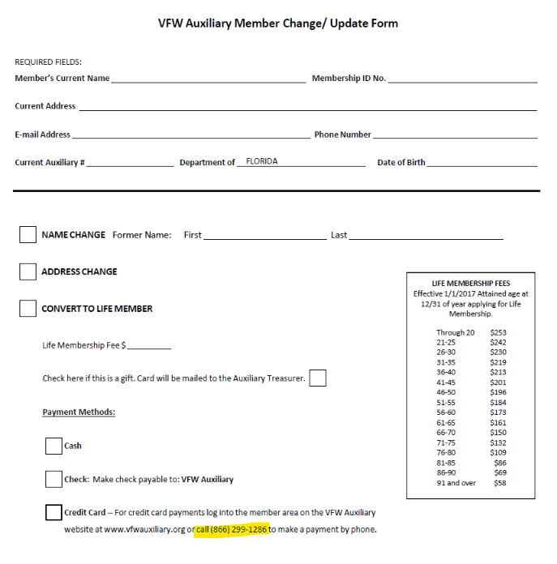
ANNUAL MEMBERS CONVERTING TO LIFETIME
Credit card payment can be made by the member in MALTA or they may pay by phone at (866) 299-1286

Slide 17
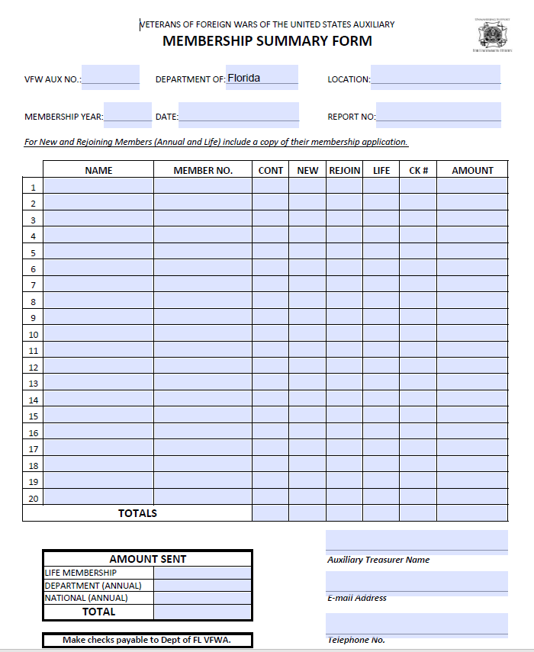
VFW AUXILIARY
MEMBERSHIP SUMMARY FORM

Slide 18
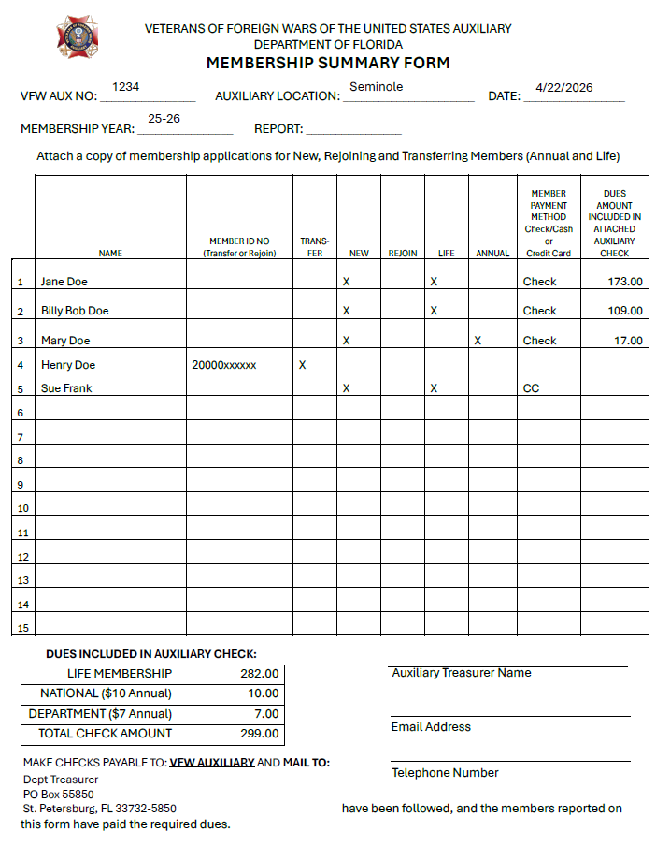
If using one (1) transmittal for all applications being submitted, categorize the applications..
All Annual Applications paid by check
All Life Membership Applications paid by check
All Applications being paid by credit cards
Preferred Method….
All Annual and Life Membership Applications paid by check listed on same transmittal but listed categorically
All Applications being paid by credit cards listed on separate transmittal

Slide 19
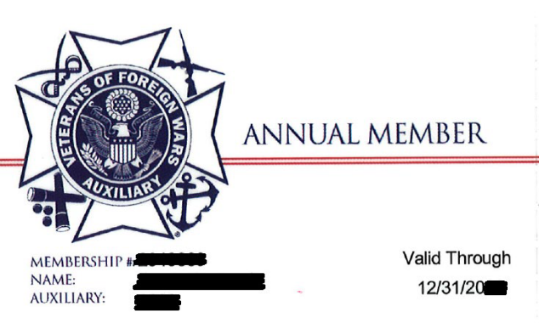
ANNUAL MEMBERSHIP CARDS
As of July 1, 2026, physical annual membership cards will no longer be issued.
Electronic / virtual membership cards can be accessed via the MALTA app or in MALTA
Auxiliary Treasurers can print paper version from MALTA

Slide 20

LIFE MEMBERSHIP CARDS
A Life Membership Card is issued free of charge when the life membership is purchased
  If not received in 1 month by the member – notify the Department Treasurer
  If 4 months or more have elapsed or the member provided the incorrect address, they must pay $10 for a new card
  A new life card is issued for free when transferring Auxiliaries
    No card will automatically be issued for the transfer to member at large or transfer back to an Auxiliary where they were previously a member
  $10 fee for replacement for:
    Name Change
    Damaged / Lost / Stolen
Electronic / virtual membership cards can be accessed via the MALTA app or in MALTA

Slide 21

WHERE TO MAIL MEMBERSHIP APPLICATIONS FOR PROCESSING
Cindy Estell, Dept Treasurer
PO Box 55850
St Petersburg FL 33732-5850

Slide 22

Membership can help for years to come

